Slide 1
Data class outline
TO BE REMOVED
Introduction
what data structures do you know? list, dictionary, set, tree, graph, array, database, …
you could store data in a dictionary as a list — what makes you choose a data structure over another? speed (dictionary retrieval O(1), list O(n), demo this) memory (on disk, in memory)
for what kind of data is each of the data structure good? list, dictionary … numpy array -> n-d grid of data of the same basic type; efficient use of memory and for loops implemented at C-level for some operations pandas DataFrame -> records of different types, e.g. info about experiment subscriber, experiment results by subscriber and condition, … ; efficient operations on columns; easy statistics and analytics on groups
homogeneous array data: numpy
only small changes to numpy class to stress the overall topics
one thing I suggest to add: memmap. What does it do, how much in this case it’s important to think about the operations we want to do on the array: view vs copy; random sampling is going to load all of the memory pages the samples are in. Even C- and Fortran-order are going to have a different impact on memory usage
mention that HDF5 can also be used for efficient on-disk storage of array data
heterogeneous, column-based data with index: pandas
the topics of this part apply to pandas, spark, SQL databases, dask, … : they all share the same basic concepts; we’ll use pandas for convenience
“tidy data” ideas
just as in numpy, avoiding for loops is critical for both memory and speed consumption
split, map, aggregate -> basic ideas, related to tidy data; summary tables, pivots
joins and anti-joins: basic and also how they can make some filtering cases easy, without for loops
window functions
coalescing: selecting one of several computations based on priority (eliminates if .. else mapping)
briefly discuss strengths of pandas, spark, SQL databases, dask
(possibly) data organization topics
data processing stages
handling changes in the data
missing values

Slide 2
Goals (will be removed)
TO BE REMOVED
Goals:
Brief introduction to data structures
why are there many? what are the trade-offs? Basic facts about Python lists, sets, and dictionaries (exercise)
arrays, grid of homogeneous data (numpy)
efficient storage in memory, interpretation layer, and C-level loops
knowing this makes it easy to understand: view vs copy; when is C- or F-order better
off-memory array: memmaps, HDF5 (and beyond C- and F-order, example 3D geodata)
blosc: memory-compressed arrays
tables, indexed columns of inhomogeneous data (pandas, dask, sql, …)

Slide 3
TO BE REMOVED
Part 1: data structures
which data structures exist?
which ones do we use most commonly in research? array, tables
why do we have many?
access time, memory, and algorithms (exercise)
Part 2: arrays (numpy)
why is it efficient? separate storage in memory from interpretation; copy vs view; broadcasting
it’s only efficient if you don’t do for loops: the for loops are done in the native C
exercises for that
memory maps -> on-disk arrays
HDF5 -> on-disk, chunked arrays
more: compressed storage (blosc)
Part 3: tables (pandas, dask, SQL, …)
calculations are done by column, rows have index
it’s only efficient if you don’t do for loops: split-group-appy, join, window functions
exercises for that
concept of “tidy data”, show example of difficult operation on table that becomes easy with tidy data

Slide 4
Data types
TO BE REMOVED
obvious but: different data structures are for storing different things
lists: sequences, ordered items -> stack, queue; sorted search
sets: bunch of items, no order
dictionaries: key-value
what’s maybe not obvious is that these data structures are specialized because they have speed or memory advantages
Q: what is the time to retrieve an item from a list? from a dictionary? from a set?
Numpy also is a specialized data structure
Q (exercise): what data structure would you use to represent
a graph? A: either a dictionary or a numpy array (adjacency matrix)
a sound wave?
have a look at Advent of Code to find other examples
Notes:
Bugs are inevitable

Slide 5
All the data structures
TO BE REMOVED
list: ordered, heterogeneous storage, stack/queue, fast access by index, slow search
set: unordered
dictionary
arrays: e.g. numpy, HDF5
tables: e.g. pandas, dask, spark, SQL
graph: social network structure
tree: to rapidly search a dataset
heap
stack
queue
priority queue

Slide 6
Data structures
TO BE REMOVED
You might know the native Python data structures (ask which ones): lists, tuples, sets, and dictionaries
There are also other data structures in the standard libraries
There is a whole theory of data structures
For example:
queue
priority queues
I want to give a taste of how to think about data structures:
what is stored
what are the operations that can be done on them
how they are implemented and how efficient that is, is another matter (e.g. representation of graphs in matrices vs dictionaries)
you don’t need to know the implementation, just the efficiency of each operation

Slide 7

The data class a.k.a. the Pandas class (but it’s not)
Pietro Berkes & Verjinia Metodieva

Slide 8
What are data structures?
Not in a slide, this is an interactive part
Which data structures do you know? write down, start with the ones they use 90% of the time, ask for more exotic ones
Tou could store data in a dictionary as a list — what makes you choose a data structure over another?
what are the things you need to take into account when thinking about data?

Slide 9
What problems do you encounter with data?
This is an open question to the class
Processing
Storage
Reproducibility and collaboration
Efficient processing (no for-loops!)
Organizing data so that analyses are easy
Size
Access ease
Access time
Versioning
Lineage tracing (which script / other data was used to generate this?)
Ease of sharing
These are criteria for selecting a data structure

Slide 10
How do we think about scaling in performance in data structures? Or in algorithms in general
You developed your code on a small data set, how is it going to scale to the complete data set?
What counts is how the computing time scales as the data becomes larger! That’s by far the dominating factor. We’re interested in order of magnitude.
Development data
Real data
N data points,
Processing time T
10x N data points
Processing time -> ?

Slide 11

How performance scales: big-O
Big-O class | What we call it | How time increases when the data increases 10x | Operation on lists that scales this way
O(1) | constant | 1x time
O(n) | linear | 10x time
O(n^2) | quadratic | 100x time
O(n * log n) | linearithmic | ~10-20x time
O(log n) | logarithmic | ~1-2x time
Fill this column with them: can you think of any operation on lists that scales this way?
VM: add plot with scaling for all of the Big-O classes above

Slide 12
How performance scales: big-O
Big-O class | What we call it | How time increases when the data increases 10x | Operation on lists that scales this way
O(1) | constant | 1x time | Getting first element
O(n) | linear | 10x time | Summing data in list
O(n^2) | quadratic | 100x time | Double for-loop through list, e.g. create a matrix with the difference of every pair of elements
O(n * log n) | linearithmic | ~10-20x time | Sorting the list
O(log n) | logarithmic | ~1-2x time | Searching an element in a sorted list

Slide 13
How performance scales: big-O
Big-O class | What we call it | How time increases when the data increases 10x | Operation on lists that scales this way
O(1) | constant | 1x time | Getting first element
O(n) | linear | 10x time | Summing data in list
O(n^2) | quadratic | 100x time | Double for-loop through list, e.g. create a matrix with the difference of every pair of elements
O(n * log n) | linearithmic | ~10-20x time | Sorting the list
O(log n) | logarithmic | ~1-2x time | Searching an element in a sorted list
Question: how does parallelization, or re-writing the code in a faster programming language, influence the performance?
E.g. parallelize O(n^2) problem
In general we need to distinguish between “fast” in absolute terms for a fixed problem size, and “fast” in the sense of how well it scales

Slide 14

VM: please work on this slide
Fast code
O(n^2)
Regular code
O(n)
Regular code
O(n)
Fast code
(parallel, Cython)
O(n^2)

Slide 15

Example: Find common words
Problem: given two lists of words, extract all the words that are in common

Slide 16

Implementation with 2x for-loops
What is the big-O complexity of this implementation?

Slide 17
Implementation with 2x for-loops
What is the big-O complexity of this implementation?
n * n ~ O(n^2)

Slide 18
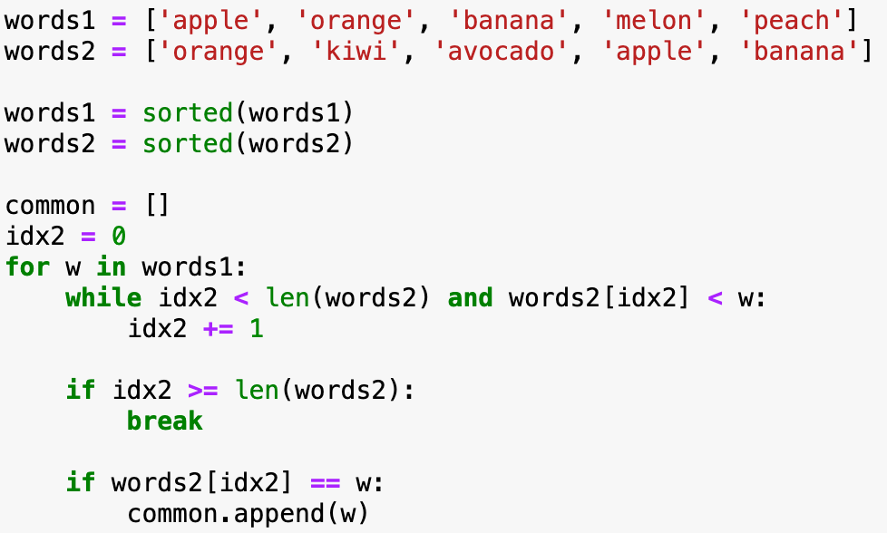
Implementation with sorted lists
Display sorted lists
FORMAT FORMULAS so that it’s easier to read
What is the big-O complexity of this implementation?

Slide 19

Implementation with sorted lists
FORMAT FORMULAS so that they are easier to read
What is the big-O complexity of this implementation?
2 * sorting + traversing two lists = 2*n log n + 2*n ~ O(n * log n)

Slide 20
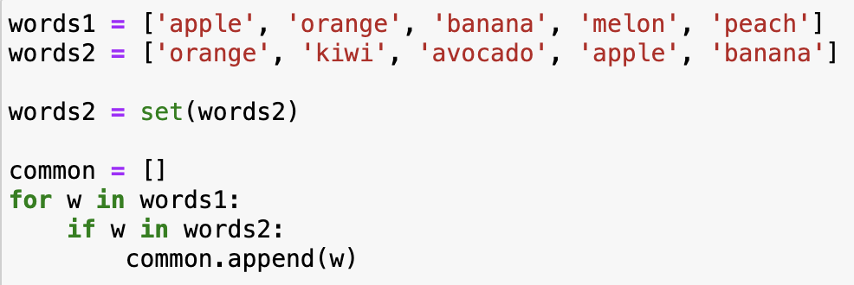
Implementation with sets
What is the big-O complexity of this implementation?

Slide 21
Implementation with sets
What is the big-O complexity of this implementation?
transforming one list to set + 1 for loop = 2 * n ~ O(n)
It’s the exact same code as for lists, but now looking up an element in sets (if w in words2) takes constant time!
How could you have known that set lookup is fast? Learning about data structures!

Slide 22
Basic information about Python data structures
Note that there may be different implementations of these data structures with different complexities, these are for the Python implementation.
E.g., if finding an element in a list is important, one could implement it as two dictionaries, one mapping indices to data, one mapping data to indices. Finding out the complexities of all the operations with this implementation is left as a homework.
lists: collection of ordered, arbitrary data
getting an element by index: O(1)
appending: O(1)
inserting an element: O(n)
sorting: O(n * log n)
finding an element (e.g., ”if element in my_list: …”): O(n)
dictionaries (”hashmaps”)
inserting: O(1)
finding element by key: O(1)
sets (it’s just dictionaries without values)
inserting: O(1)
finding an element (e.g., ”if element in my_set: …”): O(1)

Slide 23
Exercise
THIS MIGHT BE TOO DIFFICULT, we need to find another one
You are given a long list of English words
The goal is to find all the anagrams of an input word
What data structure to use for the list of words?
Write the algorithm
What is the Big-O class of your algorithm?

Slide 24
NUMPY

Slide 25
Numpy content draft
What is an array? continuous block in memory, metadata to interpret it
1. memory efficiency
show metadata: dtype, shape, stride
this explains view vs copy
questions: is this a view or a copy?
explain broadcasting in this view
2. speed efficiency with C-level loops: it requires using vectorized operations! or Cython
explain why
vectorizing exercise
3. memory + speed: C-order / F-order
4. beyond memory (briefly, optional): memmap (keep large array data on disk) and HFD-5 (block-order, example from geophysics project), blosc (compressed data)
COORDINATE WITH TIZIANO
ask: 2D array, double for-loop vs vectorized, does it change the complexity class?
COORDINATE WITH TIZIANO: memory pages, how does he talk about it

Slide 26
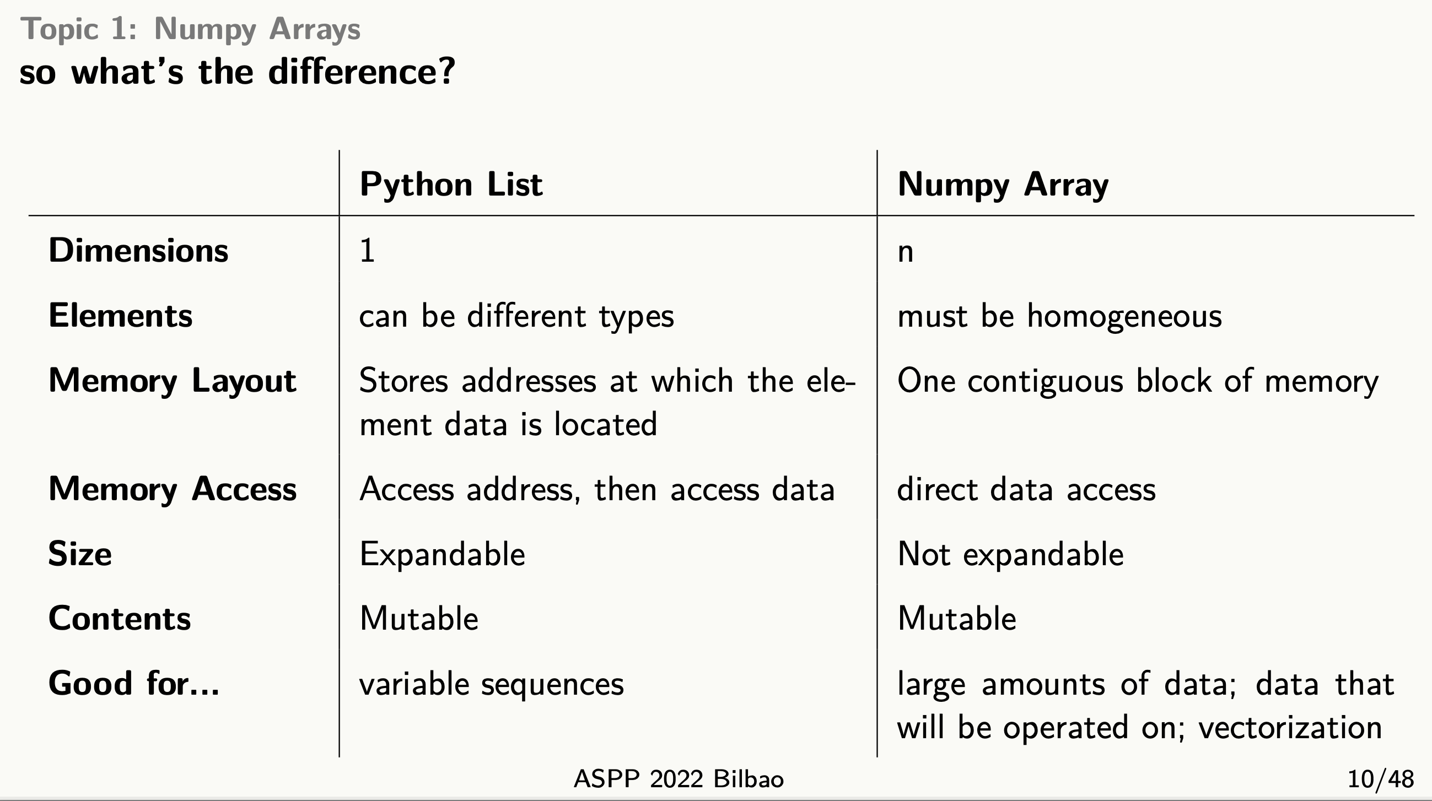

Slide 27
NumPy – huh, yeah – what’s it good for?
NumPy’s main contribution is to introduce new data structure: the array
Questions to class:
What is an array?
What are the strong features of an array? Why is it better of a list-of-lists?

Slide 28
Array: an N-dim grid of homogenous data
An array is a regular, N-dimensional grid of data of the same type, typically numerical data

Slide 29
Strength 1: Memory organization

Slide 30
Strength 2: Fast vectorized operations
Related to memory: the data is of a C numerical type, and the layout is regular in memory. A C loop can jump from one memory location to the next by moving by “strides” bytes and accumulating the results
Compare that to what happens when you do a Python for loop (need illustration)
x.sum()
vs
result = 0
for j in range(x.shape[0]): result += x[j]
Fast in the sense of absolute speed, the Big-O efficiency is the same

Slide 32
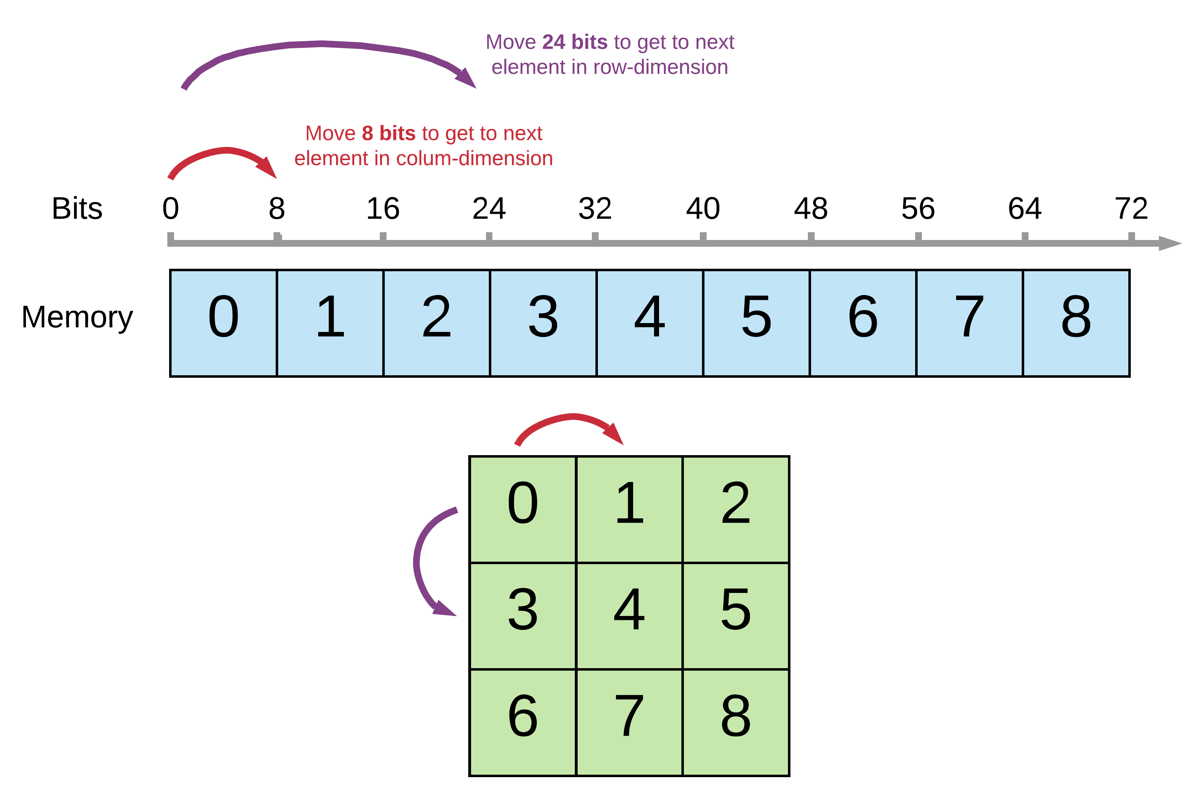

Slide 34
TABULAR DATA

Slide 35
Tabular data
A very common type of data is tabular data
the most common data format on the planet! think about Excel
by experience, many scientists think they don’t have that kind of data, but they do ! you all have tabular data, if not in the experiments (e.g. images), then in the metadata of the experiments
show example:
experiment name, researcher, date start, date end, parameter1, parameter2, participant, results_id
or it could be the same data on different days
index: day
columns: wind direction, temperature, cloud coverage
What is it? columns have different types, rows can have an index
Q: What structure can hold tabular data well?
database-like storage
it depends on the usage, most databases optimize retrieving by index (explain tree-index)
other databases are column-based, they store every column independently, operations on columns (e.g. the mean of a column) is more efficient

Slide 36

Tabular data, the most common data format on the planet!
Excel and SQL databases rule the world!
This part apply to pandas, dask, spark, SQL databases, …
They all share the same basic concepts and operations
By experience, many scientists think they don’t have that kind of data, but they do ! you all have tabular data, if not in the experiments (e.g. images), then in the metadata of the experiments
show example:
experiment name, researcher, date start, date end, parameter1, parameter2, participant, results_id
or it could be the same data on different days
index: day
columns: wind direction, temperature, cloud coverage
Ariel Fischman holds the Guinness World Record for owning the most spreadsheet software (over 500!)
https://techcommunity.microsoft.com/t5/excel-blog/guinness-world-records-the-largest-collection-of-spreadsheet/ba-p/216592

Slide 37
What is tabular data?
What is it? columns have different types, rows can have an index
Date (index) | Wind speed | Wind direction | Rain fall (mm) | Hours of sun
7.3.2024 | 7.1 | N | 0.0 | 10
8.3.2024 | 0.3 | NW | 2.1 | 2
9.3.2024 | 1.1 | SE | 0.3 | 5
Subject | Condition ID | Presentation nr | Response time (ms) | Response
VM | 732 | 2 | 28 | LEFT
VM | 732 | 3 | 41 | RIGHT
PB | 665 | 1 | 73 | LEFT

Slide 38
Storing tabular data
Python tools
pandas: columnar, in-memory
dask: columnar, on-disk
SQL databases
optimized for retrieving rows (tree data structure for index)
transactional: groups of operations are either all executed, or none
Columnar DBs, Spark, Hadoop
optimized for operations on columns
ideal for data science tasks

Slide 39
Beyond numpy vectorization: Split-apply-combine
Tabular data has additional needs compared to arrays. Understanding how to vectorize these operations is critical for handling them
(filtering, select operations)
Summary tables (split-apply-combine): number of sales per employee per month; employment rate per age group and state; etc
Combine information across tables (merging, anti-merging): combine employee personal data table with sales table and employee vacations table; create a new employee table without employees whose name starts with ‘P’
Window functions

Slide 40
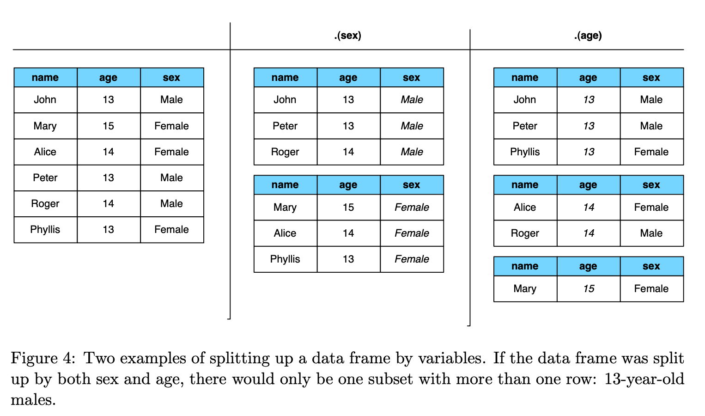
students
.groupby(‘age’)
[‘name’].nunique()
age | count
13 | 3
14 | 2
15 | 2

Slide 41
Data organization
Do this part after showing all the pivots, melt etc.
do all exercises before with tidy data, then do the last exercise with untidy data -> why was this one so difficult??
Data organization concepts:
tidy data
normalized data (star organization)
data science friendly data (denormalized)

Slide 43
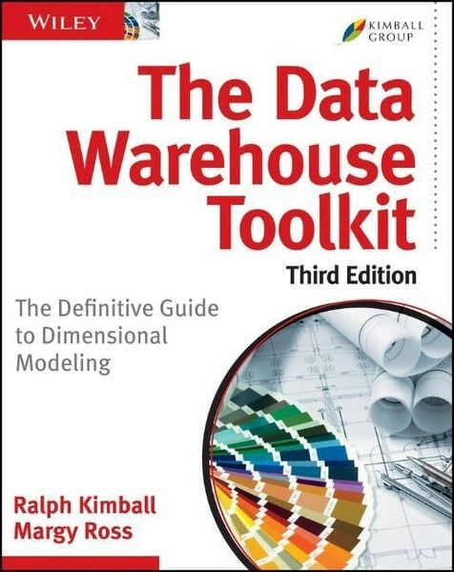

Slide 44
Thank you!

Slide 46
Lists
Content: ordered sequence on items, any data type
Operations (subset):
append
insert
“is in”
search sorted
Implementations can be different!
Python list
Linked list
numpy array
Guess the complexity
Note that a numpy array is similar, but “append” is linear

Slide 47
For example:
Accumulating results in a list vs a numpy array
list: 2*n -> O(n)
array: n * (n – 1) / 2 -> O(n^2)

Slide 48
Dictionaries (“hashmap”)
Content: unordered collection of key-value pairs
Operations:
insert
delete
is in
sets are the same but without value

Slide 49
All the data structures
list
set
dictionary
arrays: e.g. numpy, HDF5
tables: e.g. pandas, dask, spark, SQL
graph: social network structure
tree: to rapidly search a dataset
heap
stack
queue
priority queue

